Slide 1
3rd Annual Local Partner Celebration
Wednesday, May 30, 2018
2:00 PM – 4:00 PM
Charles A. Jones Career and Education Center

Slide 2
Sacramento Promise Zone Video

Slide 3
OUR MISSION
The Sacramento Promise Zone drives community revitalization in 22 square miles of the Sacramento’s most underprivileged neighborhoods. By building the capacity of partner organizations and facilitating cross-sector collaboration, the Promise Zone:
1) improves educational outcomes
2) fosters a sustainable economic base
3) accelerates job creation
4) promotes healthy behaviors
5) supports sustainably built communities

Slide 4
OUR VISION
The Sacramento Promise Zone strives to ensure that all residents in the Promise Zone, regardless of what zip code they live in, will be able to enjoy good health, improved educational opportunities, living wage jobs, economic opportunity, and sustainable communities.

Slide 5
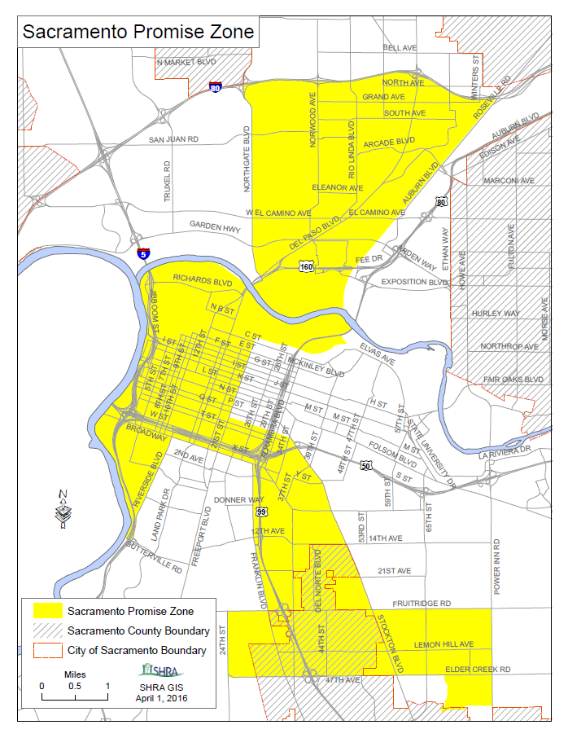

Slide 6
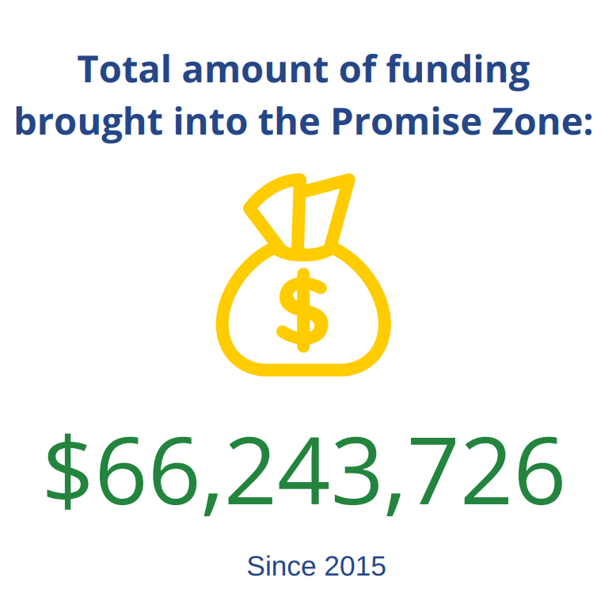

Slide 7
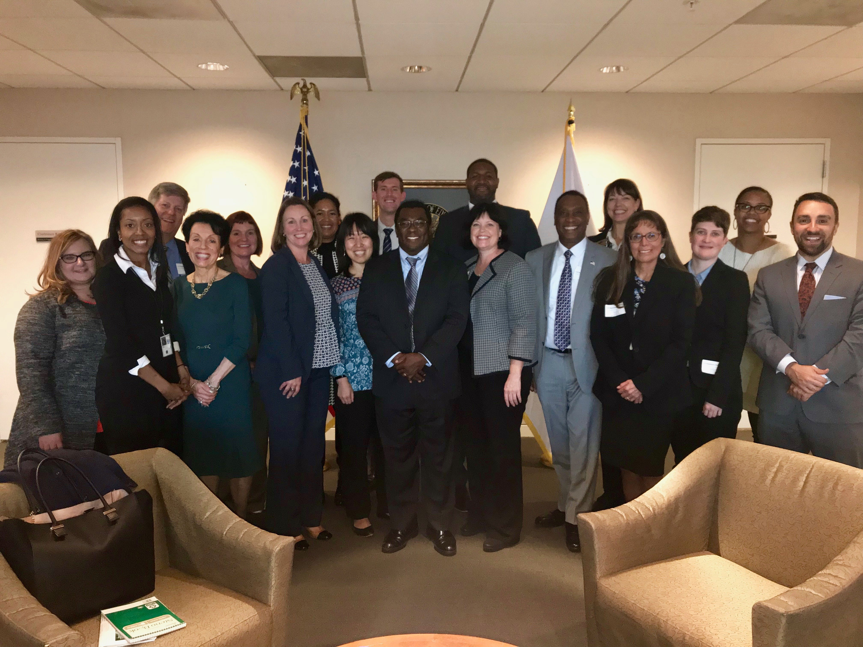
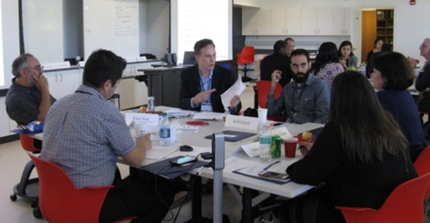
Highlights - National
National Coalition of Promise Zones | National Park Service
HUD Leadership Training | CA Education Affinity Group

Slide 8
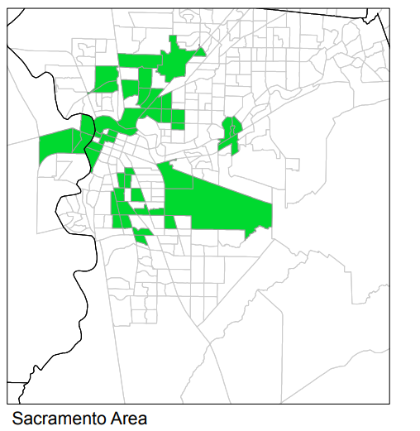
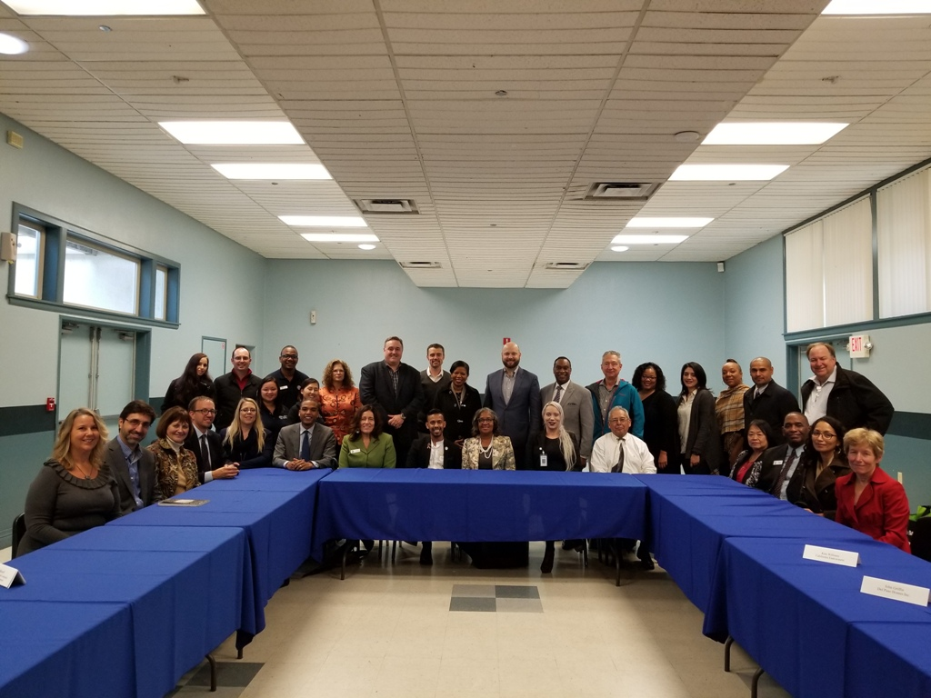
Highlights - National
Jobs For the Future – Asset Mapping | Opportunity Zones
HUD Deputy Assistant Secretary Matthew Hunter Site Visit | Federal Reserve Bank of San Francisco

Slide 9
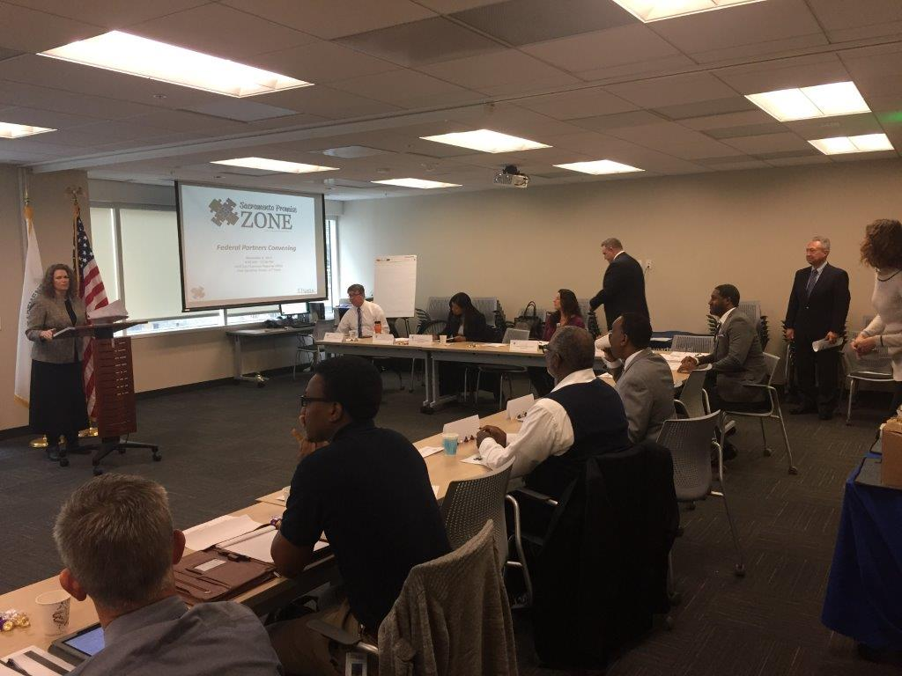
Highlights - National
Federal Deposit Insurance Corporation | Environmental Protection Agency
Annual Sacramento Promise Zone and Federal Partner Convening

Slide 10
Highlights - State
Sacramento Promise Zone Director
Tyrone Roderick Williams Appointed to State's Disadvantaged Communities Advisory Group

Slide 11
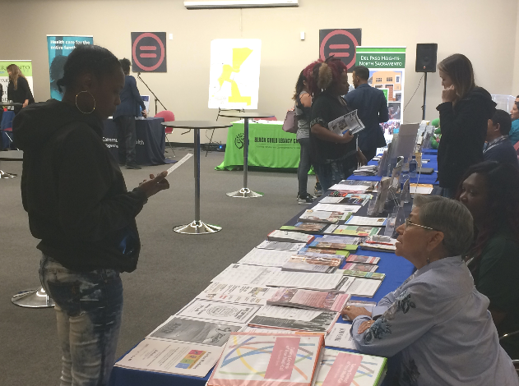
Highlights – Health & Nutrition
Elica Health Centers | Samuel Merritt University
Kaiser Permanente | Promise Zone Health Fair

Slide 12
Highlights – Job Training & Placement
Jobs Plus | Greater Sacramento Urban League
Sacramento Employment & Training Agency | Sacramento Regional Conservation Corps

Slide 13
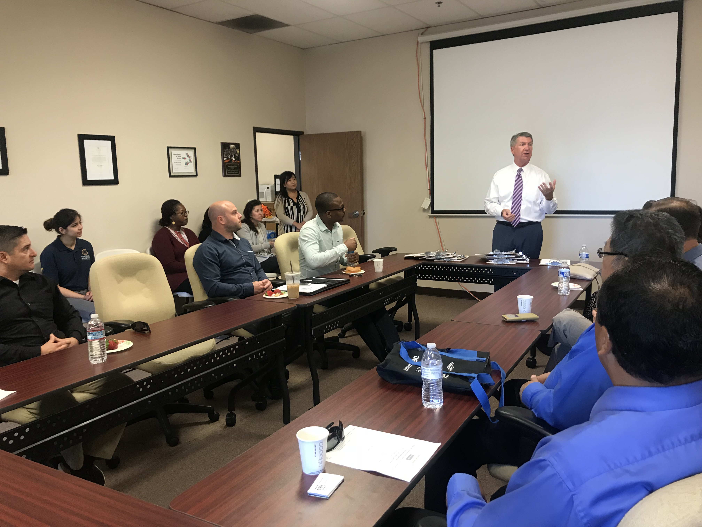
Highlights – Job Training & Placement
GRID Alternatives | Business Walk
Thousand Strong | California Capital Financial Development Corporation

Slide 14
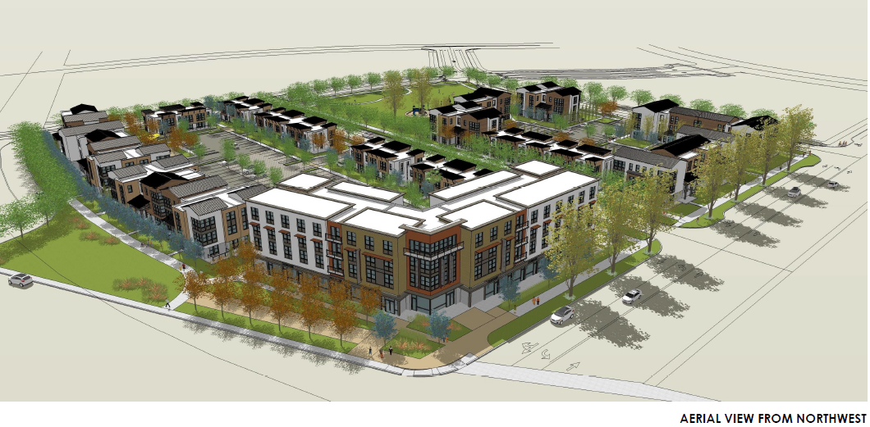
Highlights – Community Revitalization
Twin Rivers Redevelopment | Wide Open Walls
Wellness Through the Arts | Block by Block 2.0

Slide 15
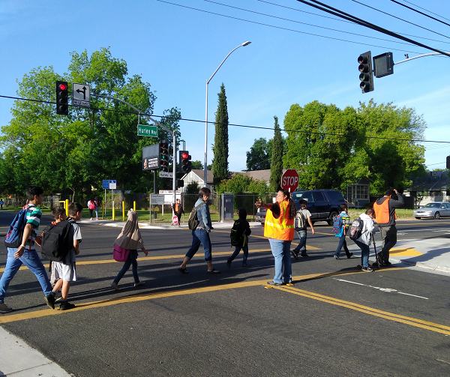
Highlights – Community Revitalization
Safe Routes to School Program | The Youth & Family Collective
Launch of Dept. of Youth, Parks, & Community Enrichment | Voter’s Choice Act

Slide 16
Highlights – Education
Sacramento State University | University of California, Davis
Sacramento City College | Sacramento County Early Learning Roadmap

Slide 17
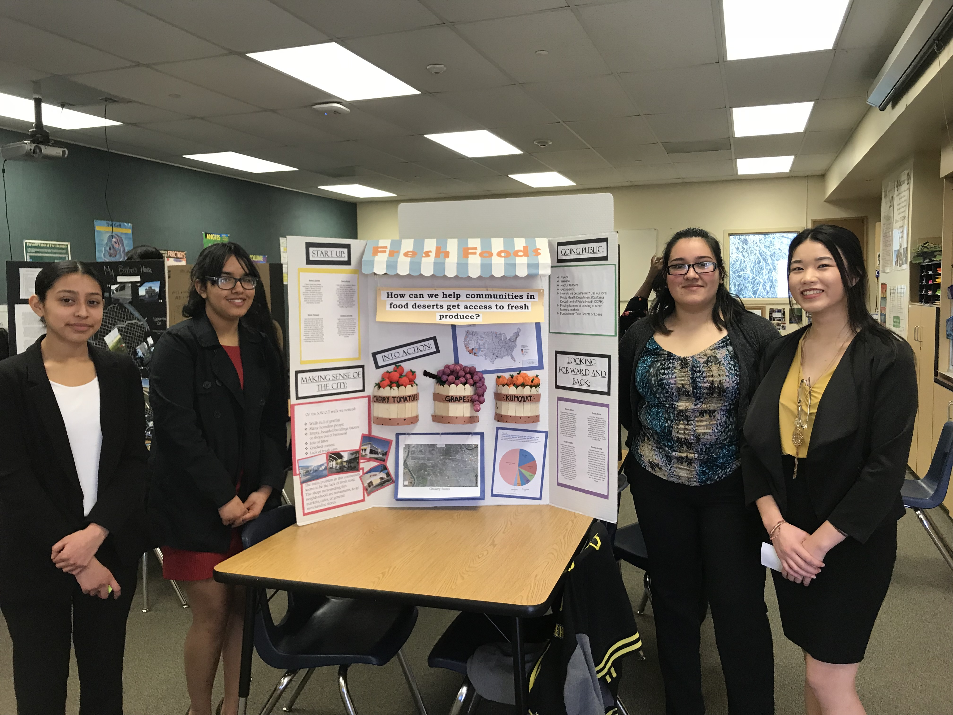
Highlights – Education
SCUSD | TRUSD
Sacramento Municipal Utility District | Y-PLAN Sacramento Healthy Cities Initiative

Slide 18
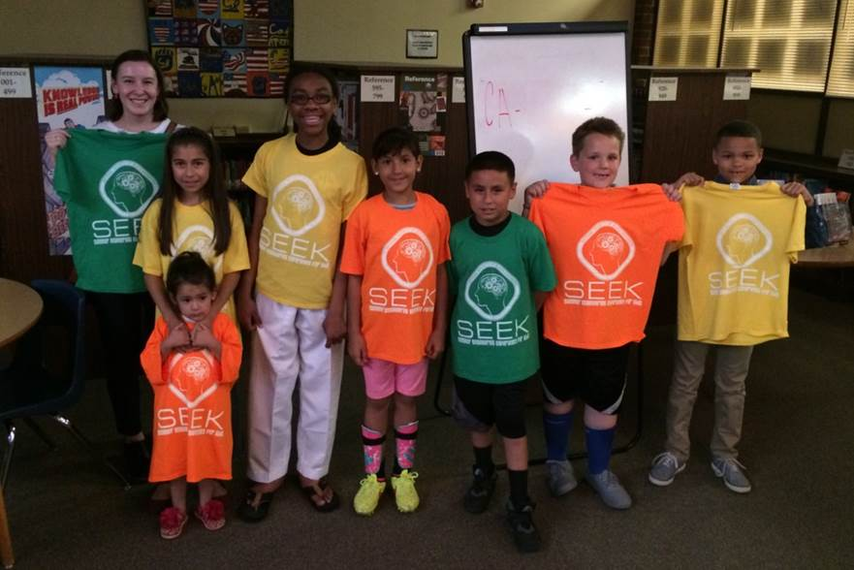
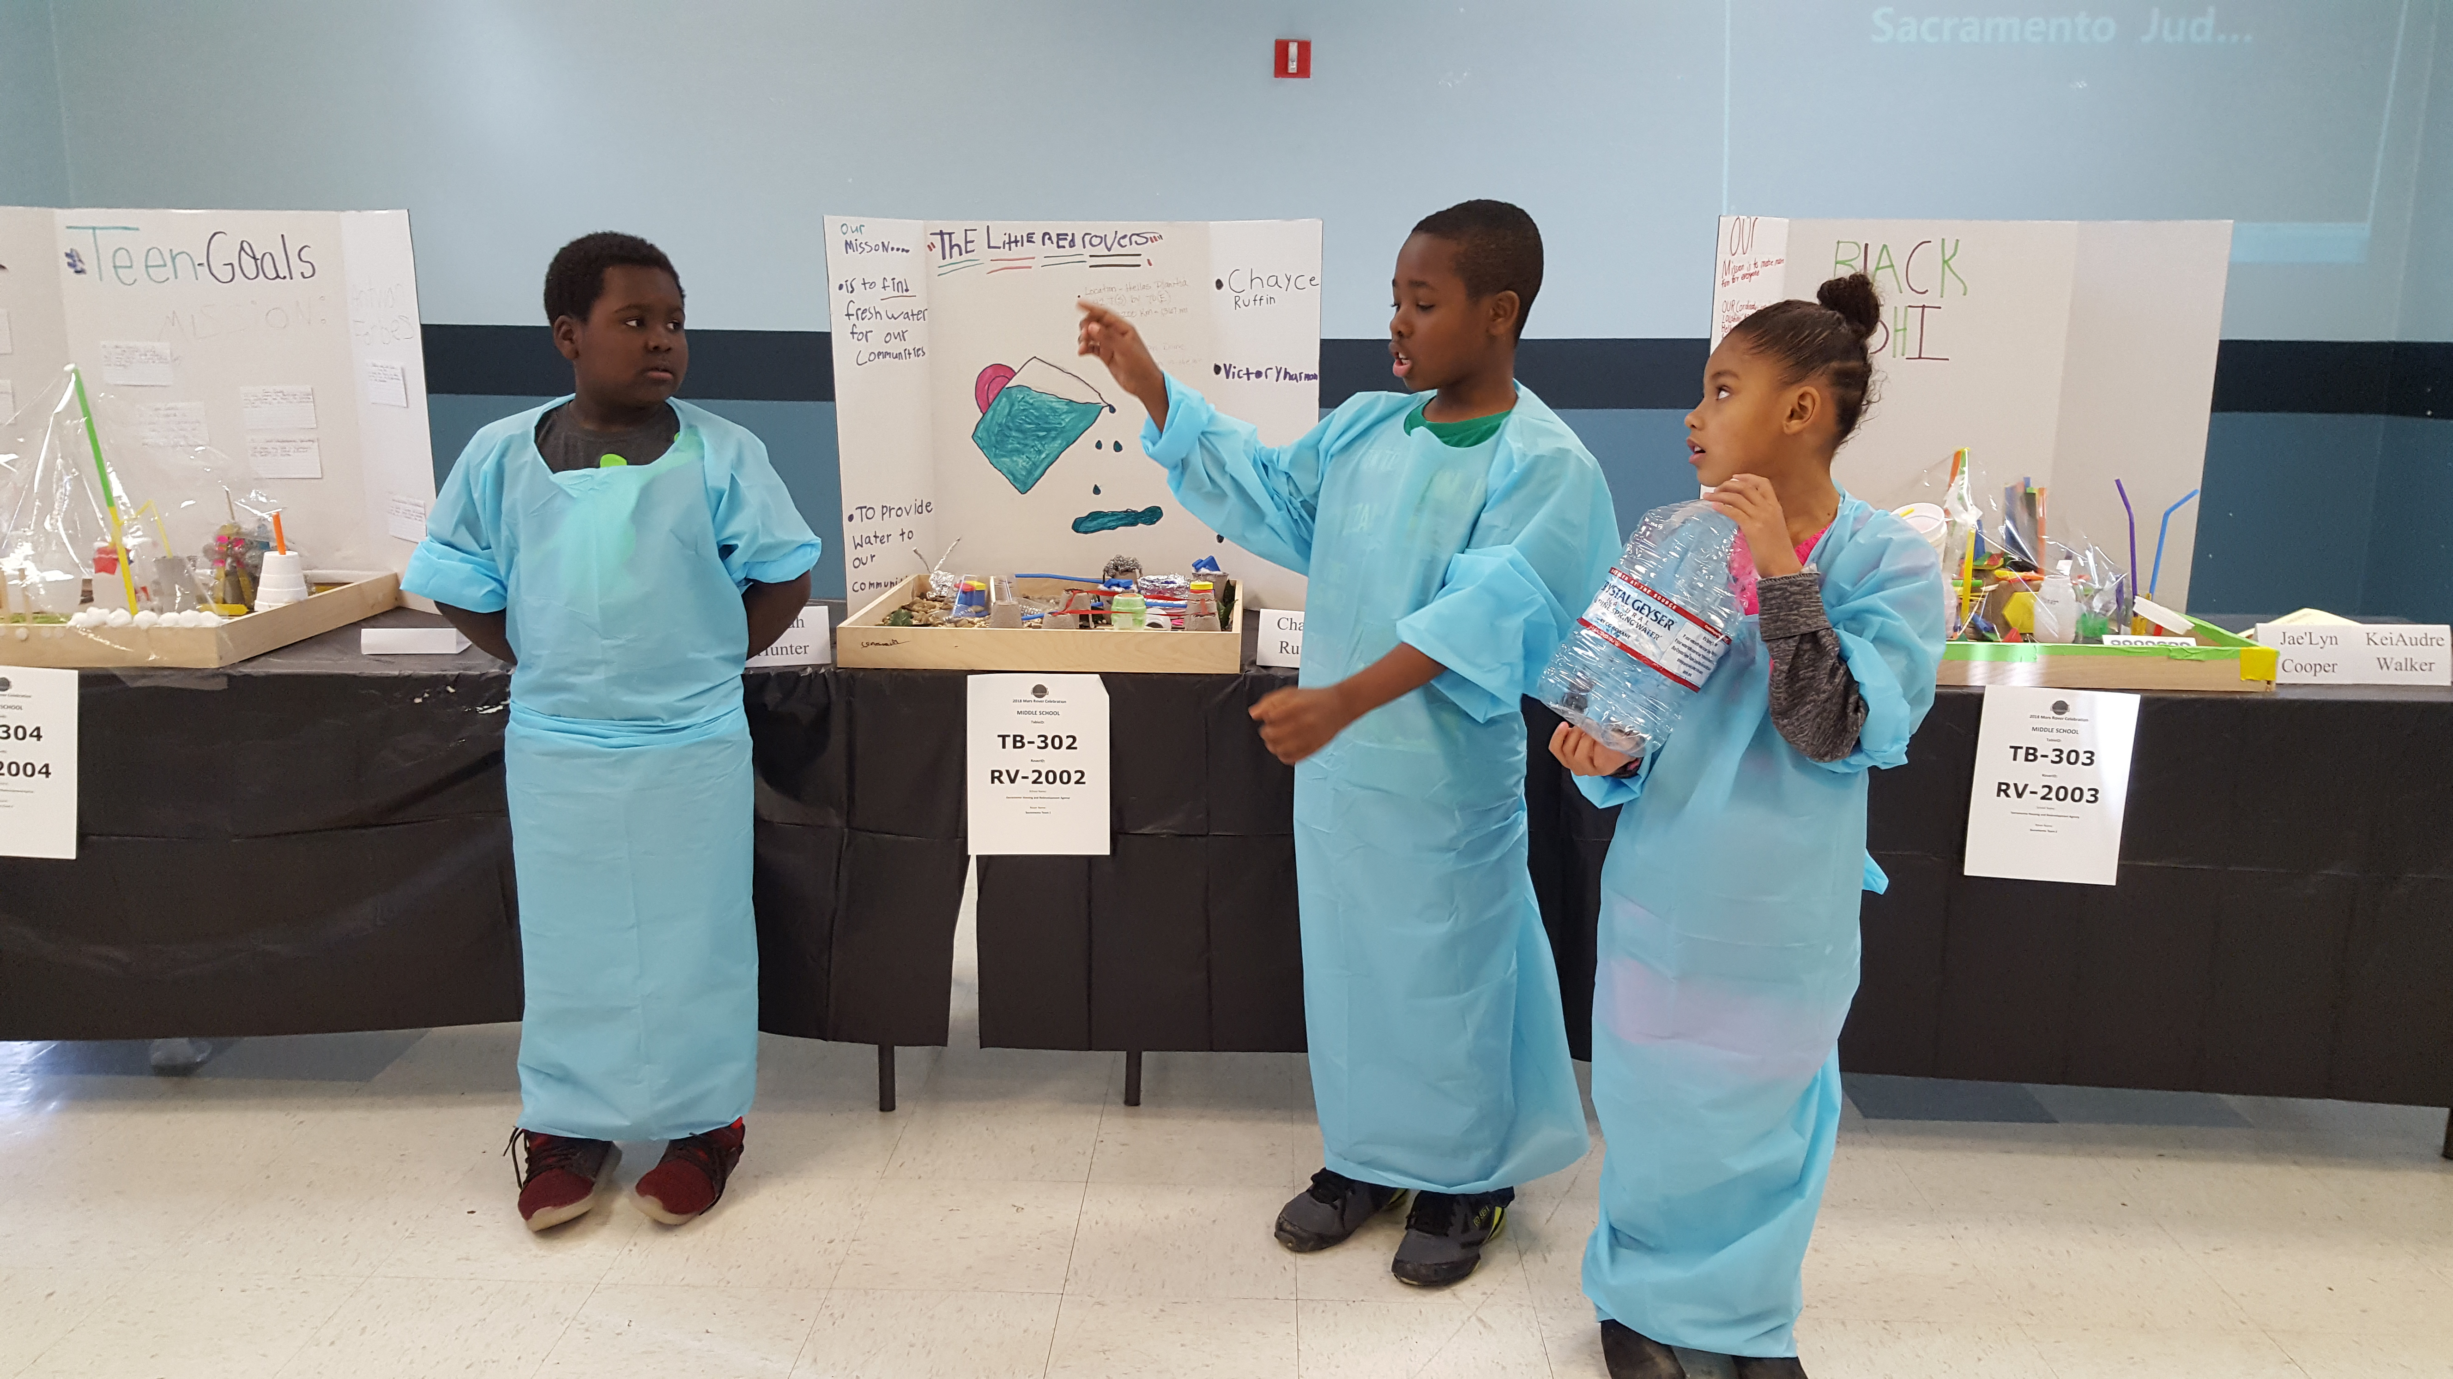
Highlights – STEM
National Society of Black Engineers | Summer Engineering Experience for Kids (SEEK)
Mars Rover Project | Square Root Academy

Slide 19
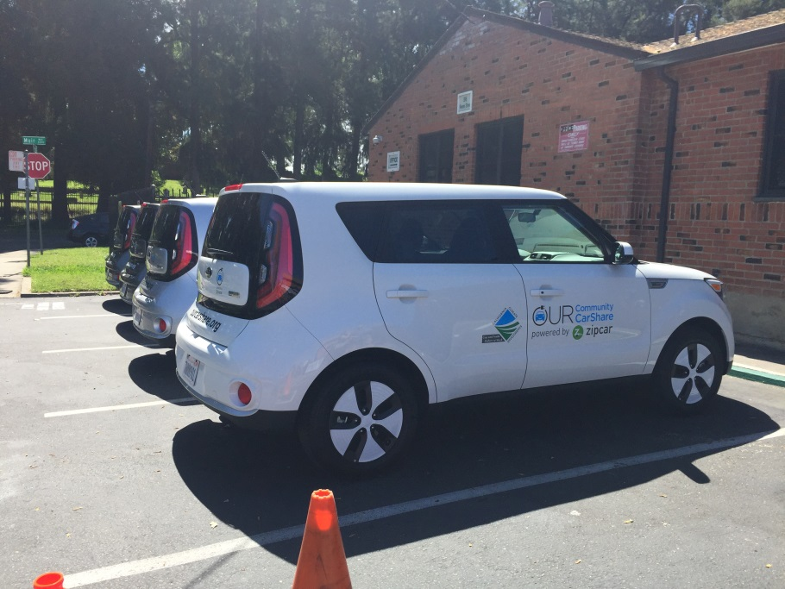
Highlights – New Initiatives
Performance Partnership Pilot | Energy Audit & Replacement Program
Zero Emission Vehicles Pilot Program | Car Share Program

Slide 20
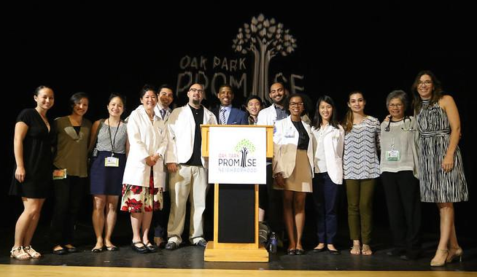
Highlights – Other Place-based Initiatives
Building Healthy Communities | Black Child Legacy Campaign
My Brother’s Keeper – Action Guide | Oak Park Promise

Slide 21
Sustainably Built Communities
Goal:
Facilitate neighborhood revitalization by creating destinations that are desirable for both working and living.
Subgoals:
1) Strengthen community capacity to address gang involvement and create safe neighborhoods, especially for men and boys of color
2) Increase the role of arts in neighborhoods and engage residents while enhancing and preserving community identity
3) Increase housing types and transit growth to promote livability and connectivity

Slide 22
Lanetria Modique
Housing Coordinator

Slide 23
Navaeh Zapata
P3 Participant

Slide 24
Education
Goal:
Increase educational opportunities for all Promise Zone students along the education spectrum – from Pre-K to higher education.
Subgoals:
1) Increase 3rd grade reading proficiency by focusing on early learning programs and results-based interventions
2) Improve retention rates by increasing basic skills competencies in reading, writing, and math to improve student preparedness for degrees, certificate courses, and employment
3) Support and improve college and career readiness programs

Slide 25
SEEK Video

Slide 26
Marinda Johnson
SEEK Parent

Slide 27
Health
Goal:
Promote healthy behaviors and increase health interventions.
Subgoals:
1) Increase adoption of local general and specific plans to improve community design that supports healthy lifestyles
2) Increase opportunities for physical activity through shared use agreements between partners in the Promise Zone
3) Implement strategies to translate and integrate known community health interventions

Slide 28
Uzo Nwankpa
Community/Public Health Nursing Lead Faculty

Slide 29
Jeanne Steer
CNC Nurse Scholar

Slide 30
Jobs
Goal:
Accelerate job creation.
Subgoals:
1) Invest in a sector approach to occupational skills training that prepares jobseekers in the Promise Zone for career pathways to middle skilled jobs that ensure self-sufficiency
2) Improve business climate for economic growth by focusing on collective efforts on reducing locally controlled regulations, and streamlining predictable permitting policies and procedures

Slide 31
Economic Development
Goal:
Promote a sustainable economic base.
Subgoals:
1) Revitalize commercial corridors within the Promise Zone; each of which is a vital asset and offer tremendous revitalization opportunities, including retail, commercial, and housing
2) Focus resources on key infill and major development projects that contribute to creating jobs, improving the quality of life and building a sustainable local economy
3) Implement and promote policy and planning initiatives that effectively improve business-friendly conditions and processes to encourage further development and investment

Slide 32
Hilary Tellesen
Workforce Programs Manager

Slide 33
Jasmine Armstrong
GRID Alternatives Participant

Slide 34
Upcoming Opportunities
Promise Zone Health Fair
June 27th from 5-7PM
Location: Maple Neighborhood Center
SEEK Program
Parent Orientation: June 17th at 6PM
Program: July 23rd – August 10th
Location: South Sacramento Christian Center
HUD data reporting & evaluation
2018-19 Financial Institution Partnership Opportunity
Resident Council
Opportunity Zones – Provide support for creating local guidelines for projects in Sacramento Opportunity Zones
HUD Urban Promise Zones Convening
VISTA Recruitment

Slide 35
Sacramento Promise Zone Sponsorship Opportunity

Slide 36
Sacramento Promise Zone:
Financial Institution Partnership Opportunity

Slide 37
2017-18 Financial Institution Partnership Opportunity Awardee:
Alchemist CDC

Slide 38
Thank You for Celebrating with Us!

